Slide 1
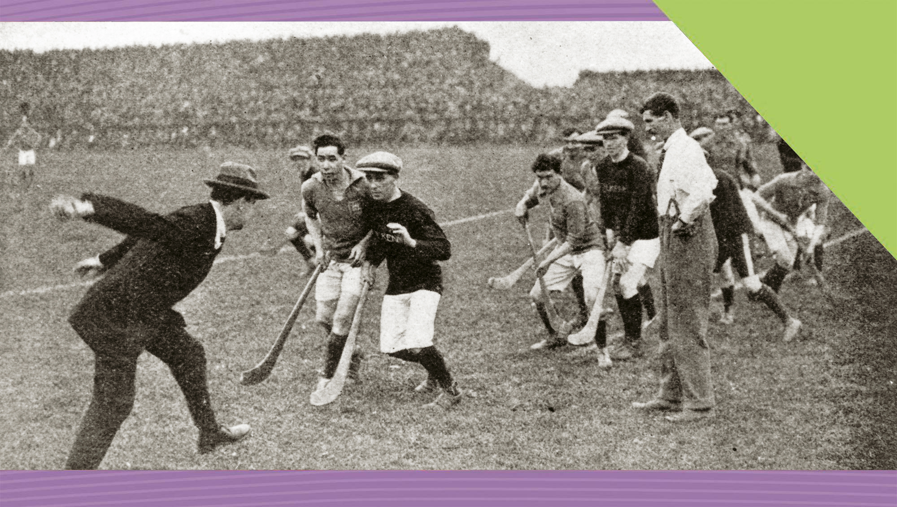
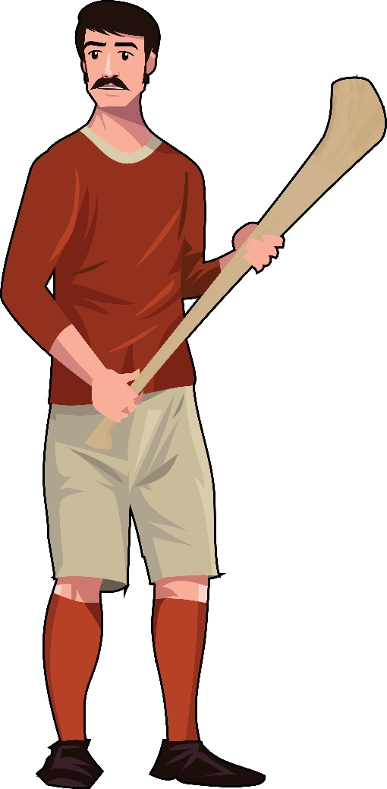

The Impact of the GAA on Irish Life
14
Making History (2nd Edition)

Slide 2

What Will I Learn?
Examine the impact of the GAA on Irish life
Explore the Nature of History

Slide 3
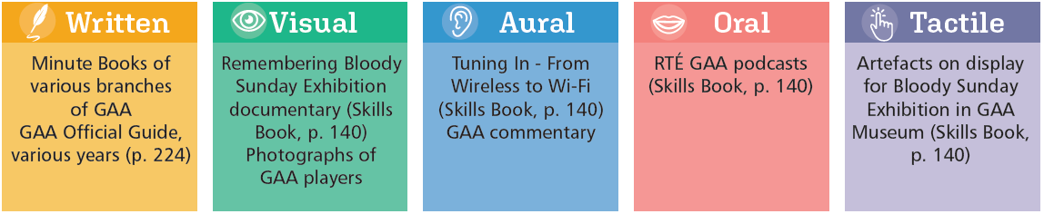
Sources for the GAA

Slide 4
Key Words
Amateur | person involved in activity without payment
American Invasion | GAA tour to the USA in 1880s
Anglicisation | becoming more English in language and culture
Camogie | a game similar to hurling with stick and ball played by girls and women
Cultural nationalism | a movement to concentrate on the shared culture of a people to create a national identity as in 19th- and 20th-century Ireland
Cultural revival | effort to revive/recover the lost or fading culture of a people as in 19th-century Ireland
Fenians | Irish political group formed in mid-19th century that believed in the use of physical force to achieve Irish independence, also known as IRB (Irish Republican Brotherhood)
Rule 21 | GAA rule that banned members of British Army and RIC/RUC from playing GAA games
Rule 27 | ‘The Ban’; GAA rule that banned members from playing or watching rugby, soccer, hockey and other foreign games
Rule 42 | GAA rule that prohibited the playing of non-GAA games on GAA pitches
Separatist tradition | Irish political tradition to separate Ireland from Britain
Voluntary | done by a person’s choice

Slide 5
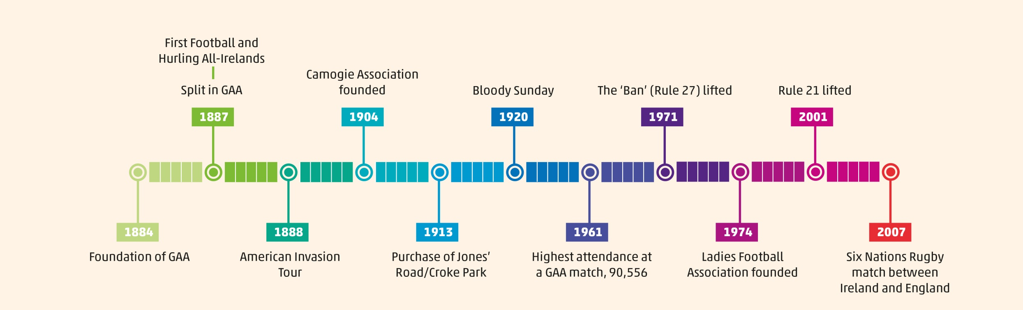
Timeline

Slide 6
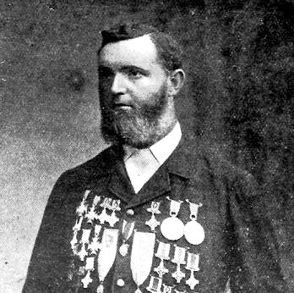
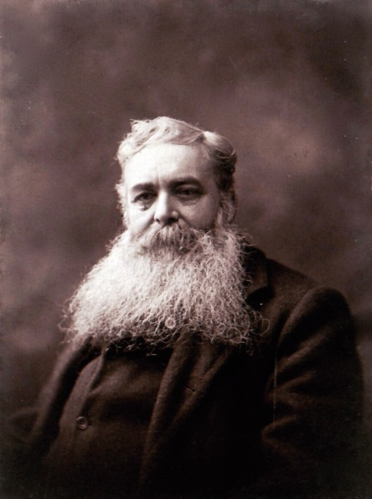
Foundation of the GAA
19th century – birth of modern sport
GAA founded in Hayes Hotel, Thurles on 1 November 1884
Michael Cusack
Keen interest in sport
Opposed to existing organisation of athletics
Wanted it opened to labourers, policemen and others
Wanted more nationalists involved
Wanted a standard set of rules for hurling
Maurice Davin
Noted athlete
Patrons
Archbishop Croke
C. S. Parnell
Michael Davitt
Maurice Davin
Michael Cusack, founder of GAA

Slide 7
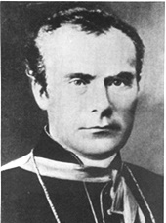
Archbishop Croke’s Letter, 1884
To Mr. Michael Cusack, Honorary Secretary of the GAA. The Palace, Thurles, 18 December 1884.
I beg to acknowledge the receipt of your communication inviting me to become a patron of the ‘Gaelic Athletic Association’ …
We are daily importing from England not only her manufactured goods … but, together with her fashions, her accent, her vicious literature, her music, her appliances and her manifold mannerisms [habits], her games also and her pastimes …
Ball-playing, hurling, football kicking, according to Irish rules …. may now be said to be not only dead and buried but … entirely forgotten and unknown.
And what have we got in their stead [place]? We have got such foreign and fantastic field sports as lawn-tennis, polo, croquet, cricket, and the like ….. still not racy of the soil, but rather alien [foreign] to it …
(T. W. Croke, Archbishop of Cashel. Published in The Nation, 27 December, 1884)
Archbishop Croke
Primary or secondary source?
Why?
Objective?
Reliable?
Useful?

Slide 8

The GAA as Part of the Cultural Revival
Cultural revival at the end of 19th century promoted all things Irish or Gaelic
Wanted to reduce English influence in all aspects of Irish life
To de-anglicise Irish society
Gaelic League founded to promote use of the Irish language
Many people members of both GAA and Gaelic League

Slide 9
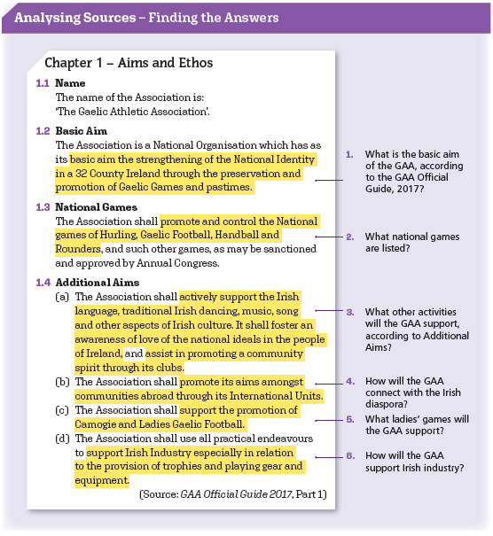

Slide 10

Assessing Your Learning
Who were the founders of the GAA?
Where was the first meeting held?
Name one of the patrons of the GAA.
What was the cultural revival?
How could the GAA be considered part of the cultural revival?
What is the basic aim of the GAA?

Slide 11
The Spread of the GAA
‘swept the country like a prairie fire’
Clubs founded in many counties
Organised athletic events as well as hurling and football matches
Clubs based on parishes led to rise in local pride
GAA CLUBS 1887–91
 | 1887 | 1888 | 1889 | 1890 | 1891
Leinster | 175 | 214 | 297 | 323 | 271
Munster | 380 | 255 | 289 | 258 | 152
Connacht | 80 | 31 | 74 | 206 | 87
Ulster | – | 6 | 37 | 88 | 47
Total | 635 | 506 | 697 | 875 | 557

Slide 12

Trouble for the GAA
Cusack and personality clashes
He was fired as secretary
The American Invasion – disastrous tour of America
Conflict in the GAA between IRB/Fenians and Home Rulers (backed by Catholic Church)
Split in the GAA
Declined for about a decade in 1890s
Revival in early 20th century

Slide 13
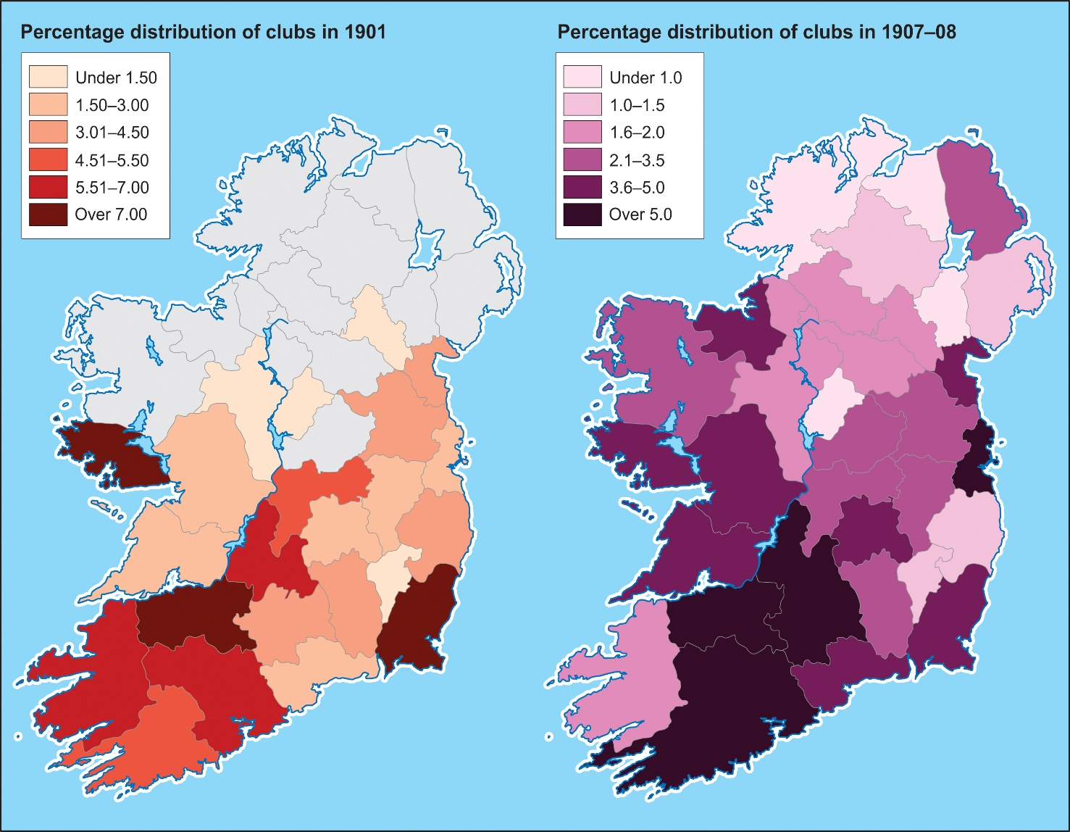

The Spread of the GAA, 1901–8
Based on this source, which of these statements are true and which are false?
Limerick, Wexford and west Galway had the highest percentage of clubs in 1901
In 1901 and 1907–08, the GAA was strongest in Munster counties.
In 1901 and 1907–08, the GAA was weakest in Ulster counties.
The GAA made progress between 1901 and 1907–08.

Slide 14
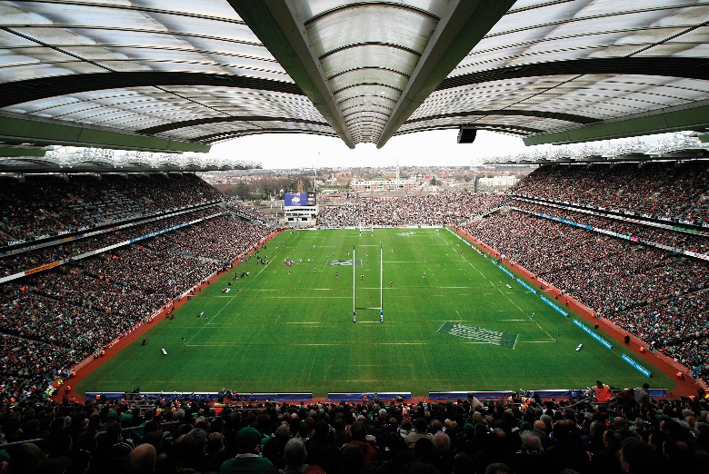
The Spread of the GAA
Development of Croke Park
Playing fields in Jones’ Road, Dublin bought by GAA in 1913
Became Croke Park
HQ of the GAA
Major venue for great occasions
Contribution to Dublin’s economy
1915
Sloped terrace
1920s
Hogan Stand
1930s
Cusack Stand
1950s
New Hogan Stand
1990s
Re-development

Slide 15
Assessing Your Learning
Complete the sentence: The GAA ‘swept the country like …’
Which province was the slowest in setting up GAA clubs? Why?
What problems arose for the GAA because of (i) Michael Cusack
(ii) the American Invasion (iii) the IRB?
In the development of Croke Park, place these in chronological order: Hogan Stand; modern development; new Hogan Stand; Cusack Stand; sloped terrace; Special Olympics; Muhammad Ali vs Al ‘Blue’ Lewis.

Slide 16
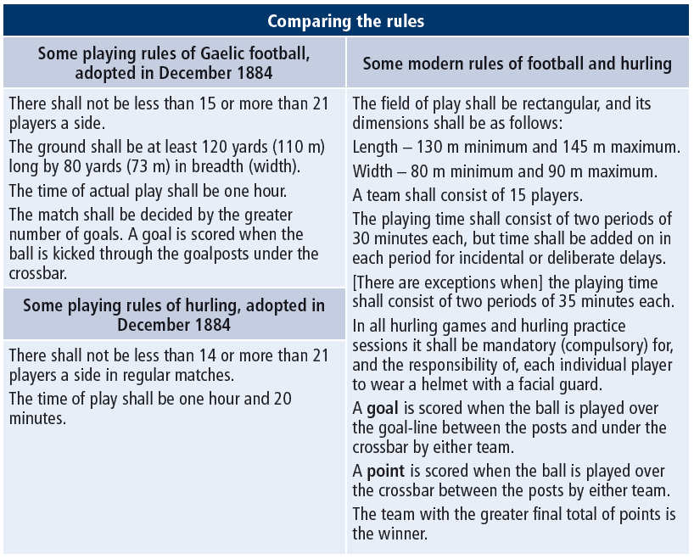

Slide 17
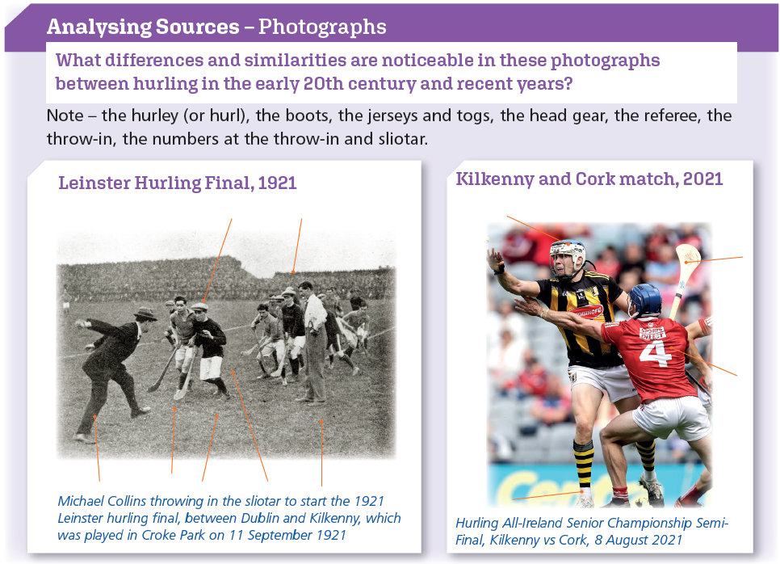

Slide 18

The GAA and the 1916 Rising
Background
GAA part of separatist tradition
Some favoured a fully independent country
Some GAA members became involved in political activity
IRB/Fenians looked on GAA as a cover for training young men for a rising
RIC reported on activities
GAA banned members of RIC playing GAA (1897)
GAA banned members playing or watching ‘foreign games’ (1905)
GAA members involved in famous funerals

Slide 19

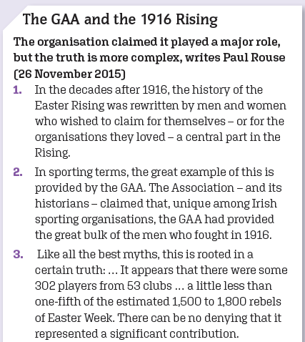
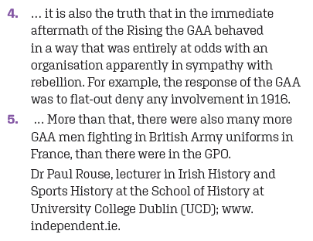

Slide 20

The War of Independence and Bloody Sunday
Bloody Sunday
Collins’ Squad killed 14 British agents
Black and Tans killed 14 people in crowd in Croke Park

Slide 21
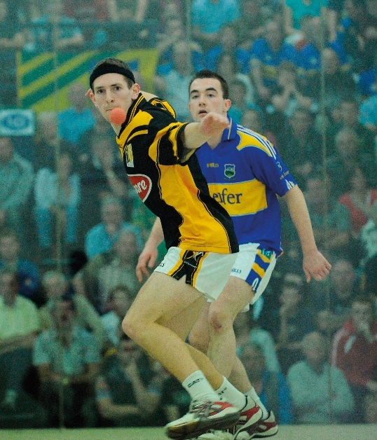
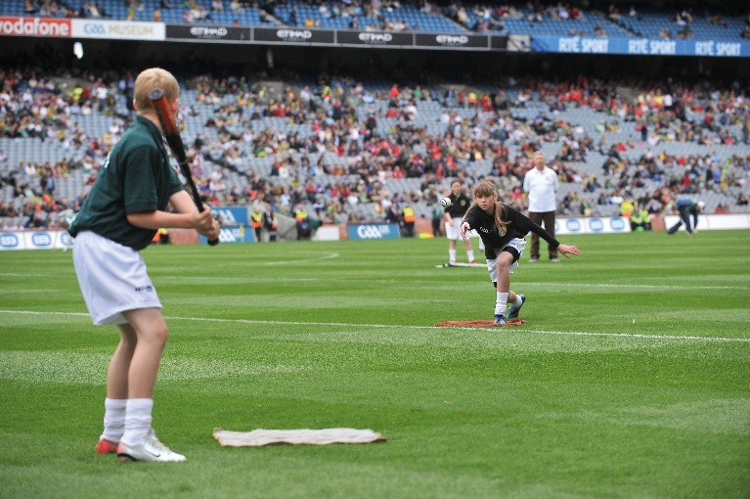
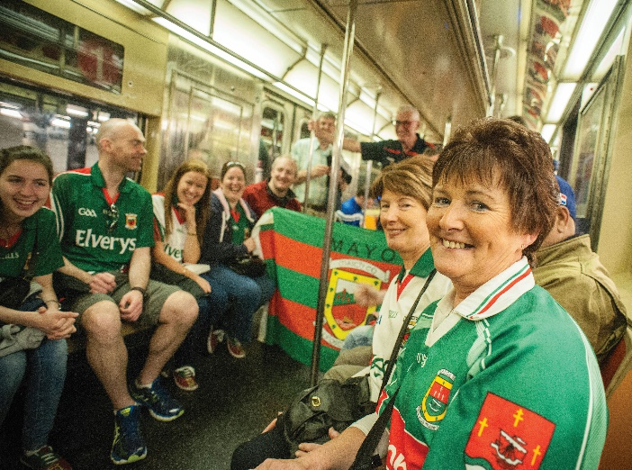
Spreading the GAA
Handball
Rounders
Irish diaspora

Slide 22
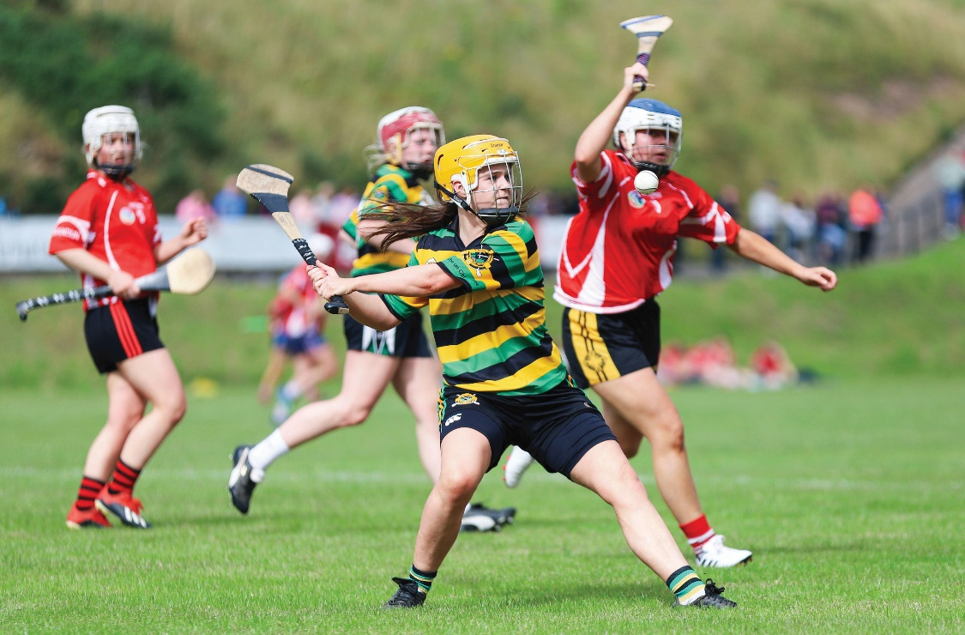
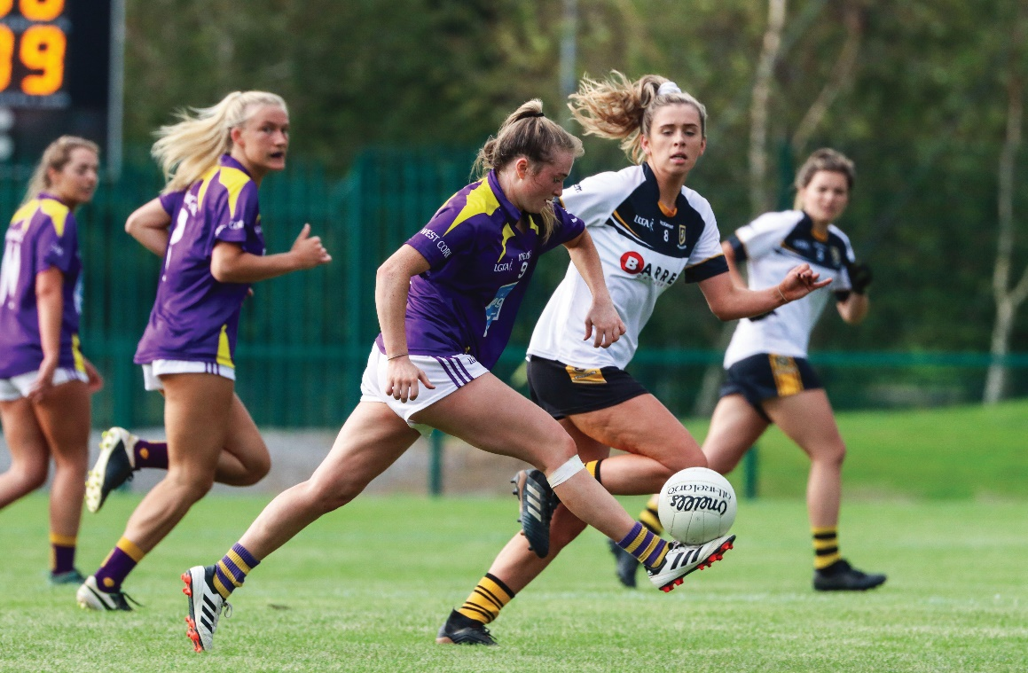
Spreading the GAA
Ladies football and camogie
Separate associations from the GAA
But active support from GAA
Camogie Association founded 1904
Ladies Gaelic Football Association founded in 1974

Slide 23
Assessing Your Learning
What was the separatist tradition?
Who believed that the GAA could be used as a cover to train young men?
Who reported on the activities of the GAA? Why?
Who were banned from playing GAA?
What were GAA players banned from playing?
Why were people shot at in Croke Park on Bloody Sunday, 1920?
What other sports does the GAA organise besides football and hurling?
What is the relationship between the GAA and camogie and ladies’ football?

Slide 24
The Impact of GAA Clubs
Club and county structure
Club based on parish
Competition and local pride
Teamwork and discipline
Blur class distinctions
Strong relationship between GAA and Catholic Church
Clubs a focus of social activity
Voluntary and amateur commitment
Promoted democratic tradition
Development of fields
The great story of my life is the story of the acquisition of fields and the development of those fields for GAA purposes and for Gaelic games alone.
Immediately roots were put down the club became the corner stone of life in a parish and so it has continued to this day. It is quite extraordinary to travel Ireland today and to see the church, the school and the GAA grounds occupying pride of place in the villages and small towns of Ireland and in the rural places.
(Pat Fanning, President of the GAA [1970–73], GAA Oral History Project, 2008)
According to this source, how important is the role of the GAA club?

Slide 25

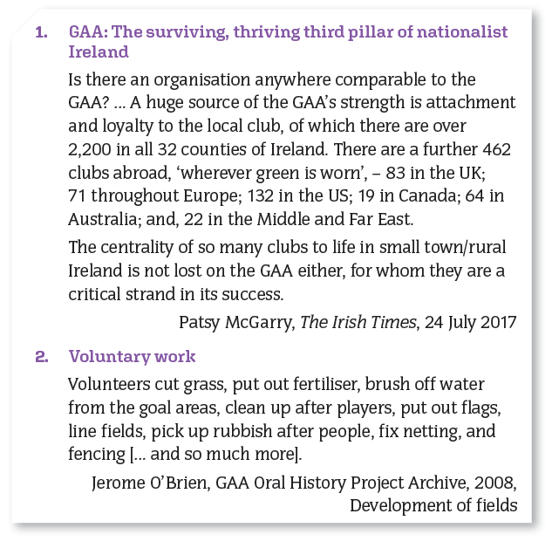

Slide 26
Assessing Your Learning
What are local GAA clubs based on? (i) the county (ii) the parish (iii) the town
What do players benefit from? (i) competition (ii) teamwork (iii) discipline (iv) being members of a certain social class
How were links between the GAA and Catholic Church strengthened?
Which of the following aspects are important in running GAA clubs? (i) professional (ii) voluntary (iii) amateur (iv) paid (v) specialised
There are (i) 500 clubs (ii) over 1,000 clubs (iii) over 2,200 clubs (iv) 5,000 clubs in the 32 counties.

Slide 27
How has the GAA ‘Moved with the Times’?
GAA kept pace with changes in Irish society
Lifted the Ban in Rule 27 in 1971
The Troubles in the North
GAA – an expression of identity for nationalists in North
Loyalists looked on GAA as ‘a nursery school’ for republicans and nationalism
Some GAA members murdered
Some GAA members harassed
Some GAA grounds taken over for security
Development of peace process
Rule 21 lifted in 2001
Improving relations between nationalists and unionists

Slide 28
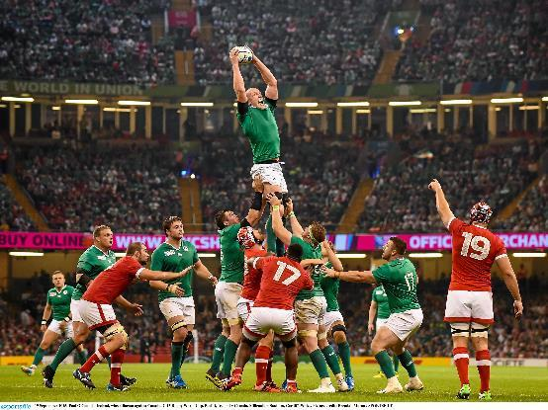
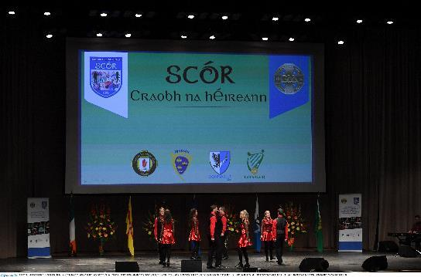
Historic Rugby Match
Ireland vs England rugby match in 2007
Rule 42 lifted for the match
Symbolic match
Greater understanding between the two countries
Maintaining Irish culture
Promoting Irish language, songs and dances
Scór – a cultural competition

Slide 29
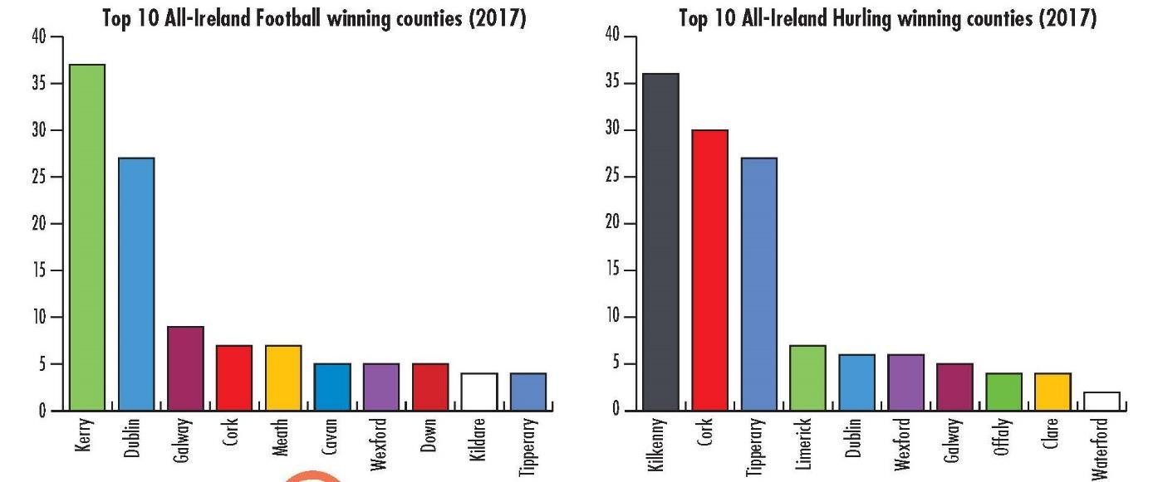
Successful Football and Hurling Counties

Slide 30
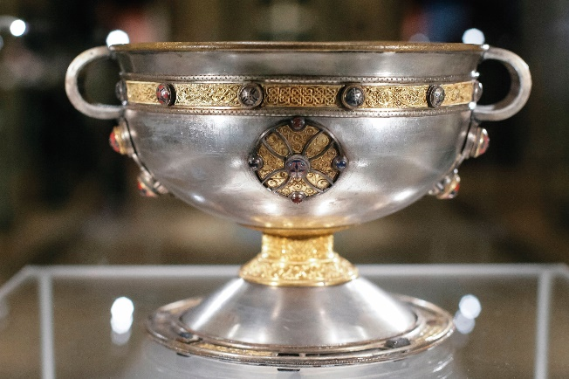
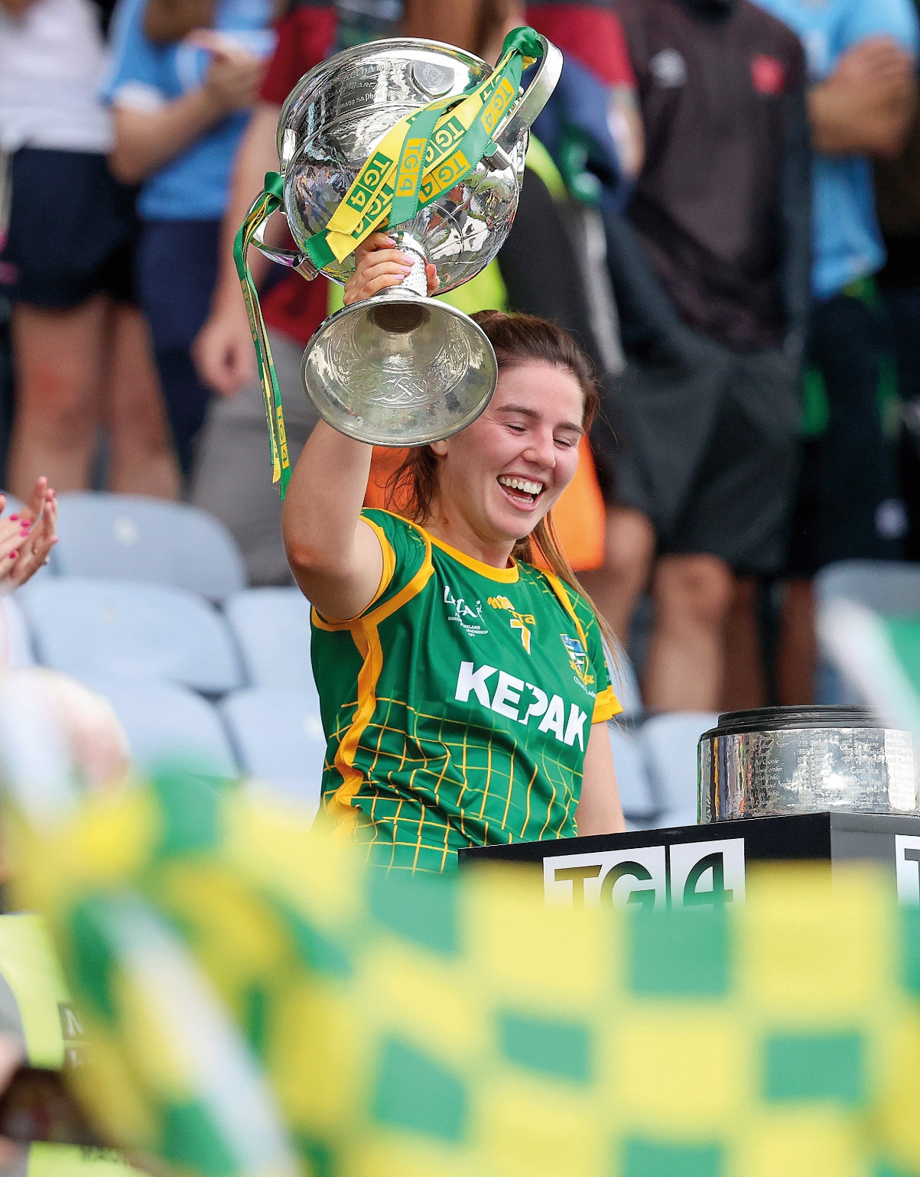
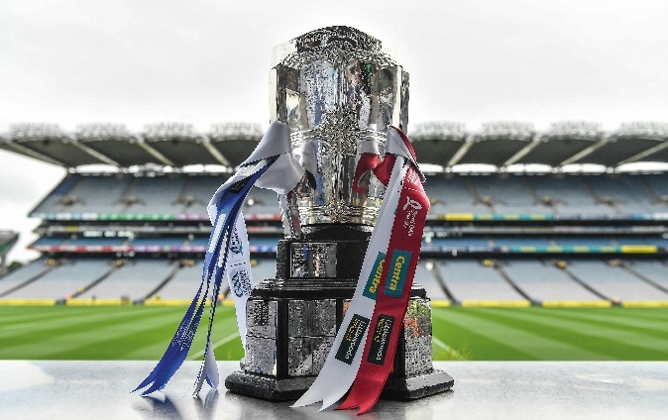
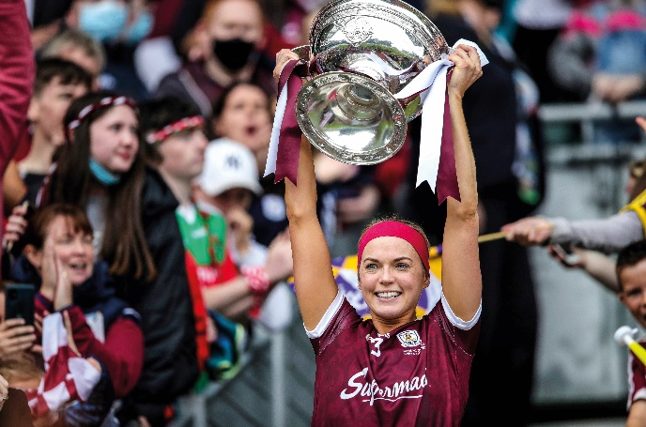
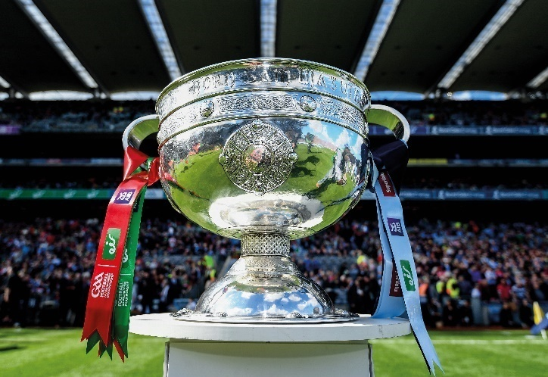
The Ardagh Chalice
The Liam McCarthy Cup
The O’Duffy Cup
The Brendan Martin Cup
The Sam Maguire Cup
How are these cups linked to the past?
Which cups are associated with which sports?

Slide 31
Summary – Impact of the GAA
Prevented further anglicisation
Boosted the cultural revival
Contributed to the political revolution of the early 20th century
Saved native games
Promoted Irish athletics
Developed local and community spirit
Increased pride in Irish culture

Slide 32
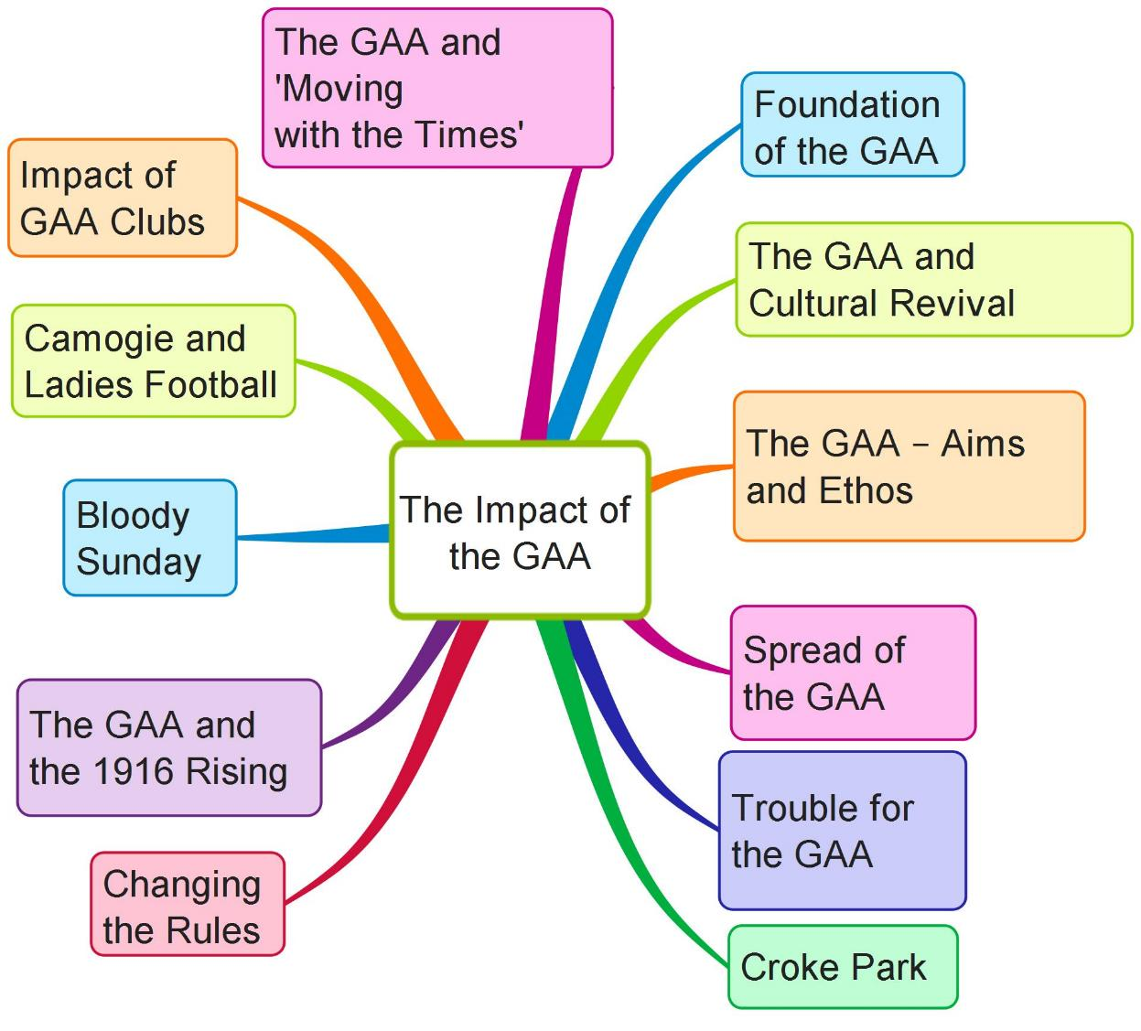
Create your own mind map on the Impact of the GAA on Irish life using the above features

Slide 33
Assessing Your Learning
Which of the following are impacts of the GAA on Irish life?
Cultural revival
Parish clubs
Croke Park
The Troubles
Hill 16 or Hill 60?
Camogie
American Invasion
Professional
1916 Rising
Democracy
Archbishop Croke
Soccer
Michael Cusack
Handball
Rounders
Community spirit
Voluntary
Cricket
Aviva Stadium
Sam Maguire
Rule 242

Slide 34
Assessing Your Learning
Match Rule 21, Rule 27 and Rule 42 with A, B, C below.
A. ‘The Ban’; GAA rule that banned members from playing or watching rugby, soccer, hockey and other foreign games
B. GAA rule that banned members of British Army and RIC/RUC from playing GAA games
C. GAA rule that prohibited the playing of non-GAA games on GAA Pitches
What trophies are presented for (i) the All-Ireland (men’s) football final (ii) the All-Ireland Ladies’ football final?

Slide 35
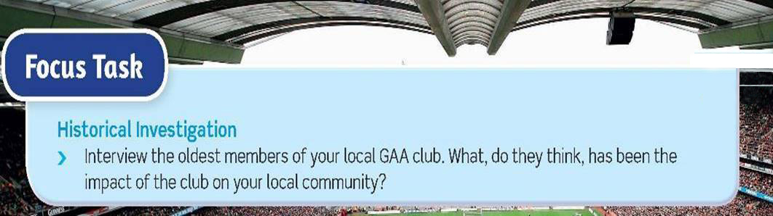
Historical Investigation

Slide 36
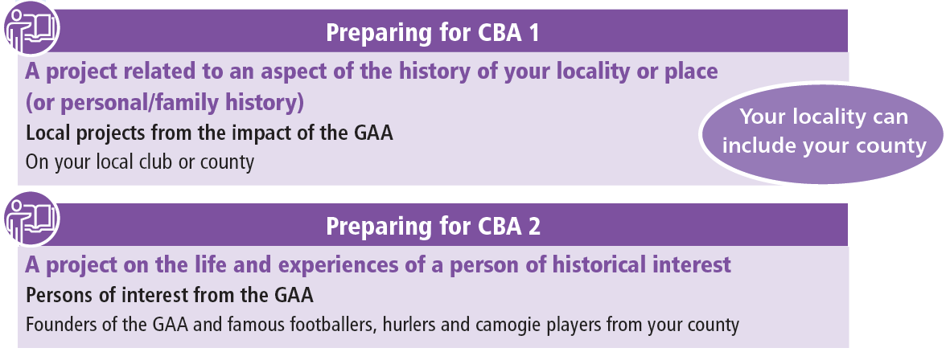
**Note your choices**

